Slide 2




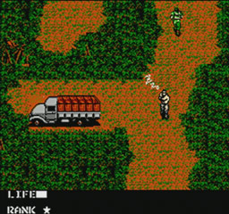
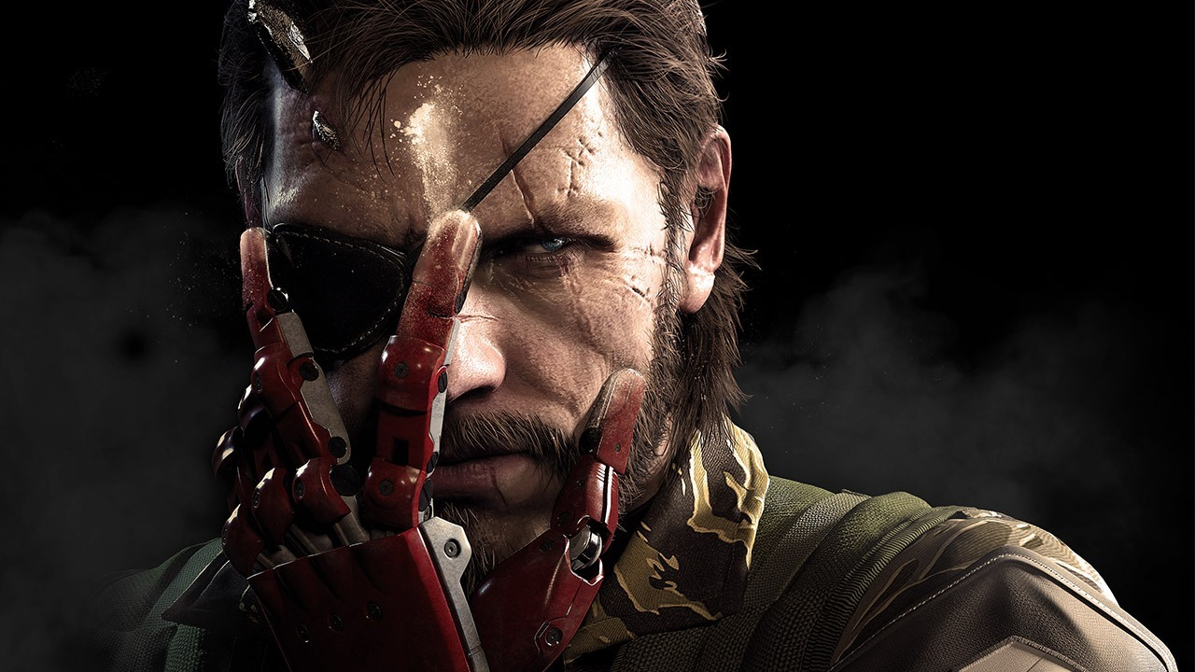
1
Workshop On Game Development
Game Theory for “Maze Runner”
Making a game isn’t about only graphics, programming and audio. It’s the underlying coherent mechanism that brings it to life.
Hideo Kojima

Slide 3
2
Workshop On Game Development
Game Theory for “Maze Runner”
Mechanic : A rule that governs the gameplay.
Events : Any incident that player experiences while playing games.
Emotion: The mental reaction of players towards these events.

Slide 4
2
Workshop On Game Development
Game Theory for “Maze Runner”
What makes great game design?
Non repetitive game rules.
Rules are not that complex, yet offer deep strategy.
Events that triggers emotion in the players mind.
Efficient use of information and “insight”.
Player experiences unique gameplay every time.
There are some “redeeming values” in the game.

